Slide 1
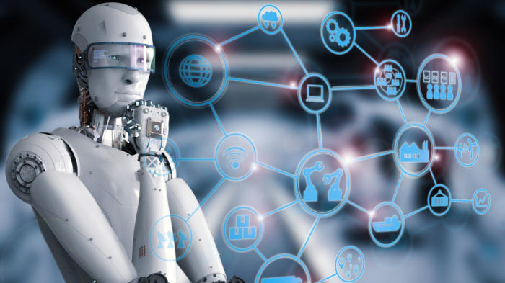
AI FUTURE INVASION TECHNIQUES
-Deepthi TM

Slide 2

AI IN CYBER SECURITY
AI provides instant insights to help you fight through the noise of thousands of daily alerts, drastically reducing response times.
AI systems are trained with data, cybersecurity firms need to feed new datasets of malicious codes and non-malicious codes regularly to help AI learn. The wrong data sets can lead to inefficiency of the system to tackle the threat

Slide 3
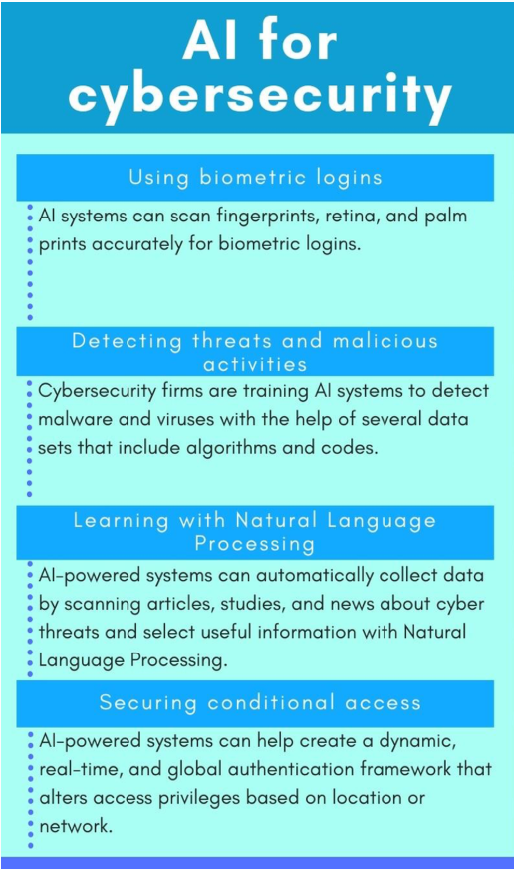
ARTIFICIAL INTELLIGANCE FOR DEFENSE
"Artificial intelligence, such as user dynamic machine learning, will find new strategies for success that a traditional human writer would simply not consider. That's because they learn from dealing with each wave of attack, fine-tuning the successes and learning from failures experienced along the way."

Slide 4
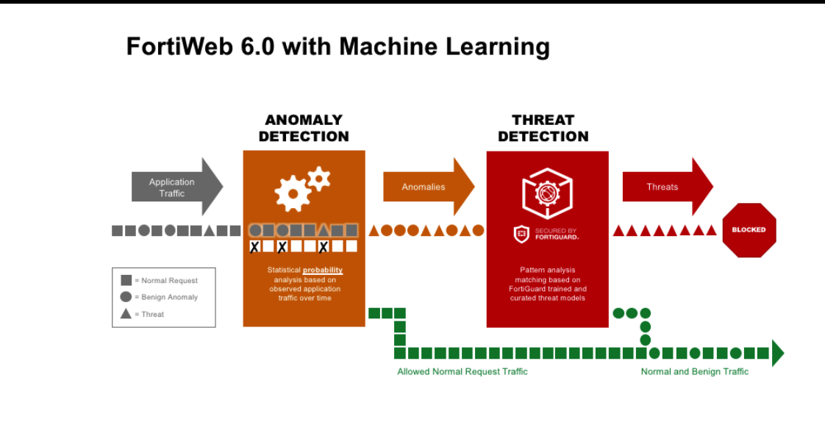

Slide 5
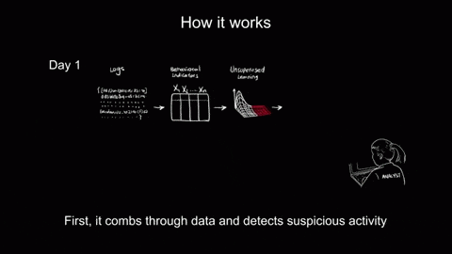
HOW IT WORKS IN REAL LIFE

Slide 6
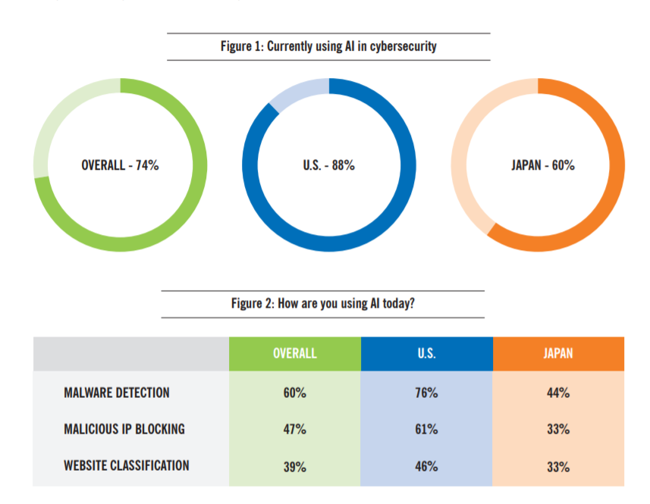
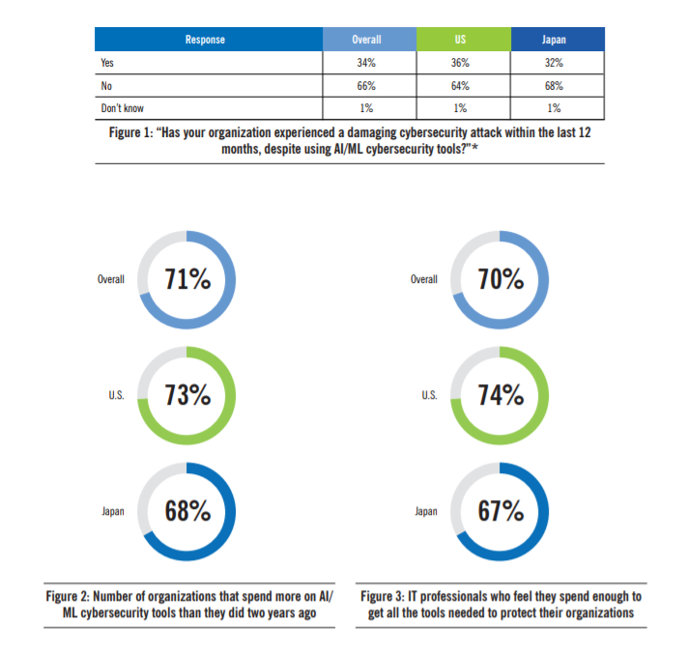
Adoption of AI in Cyber security
2019
2017

Slide 7

ARTIFICIAL INTELLIGANCE FOR ATTACKING(OFFENCE)
DeepPhish - Using deep learning to bypass AI-based phishing
Fooling deep learning-based image recognition
Web application attacks using reinforcement learning (Q-learning algorithm)

Slide 8
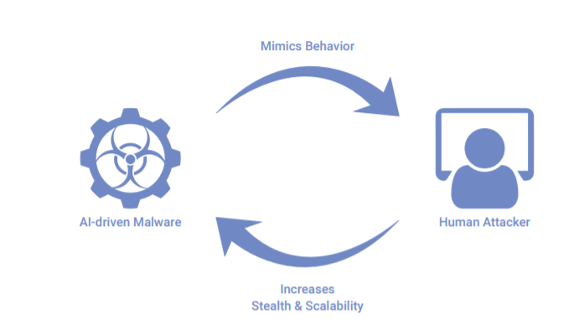
ARTIFICIAL INTELLIGANCE IN CYBER ATTACKS
Different phase of the threat attack lifecycle:
Lateral movement
Command & control traffic
Data exfiltration

Slide 9

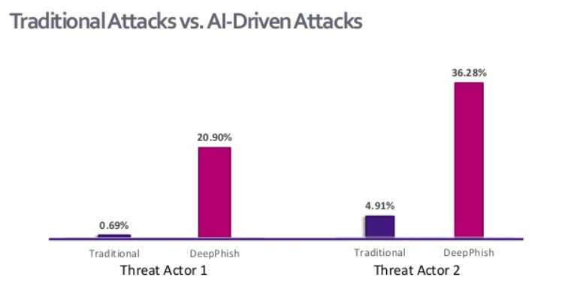
Deep Phish

Slide 10
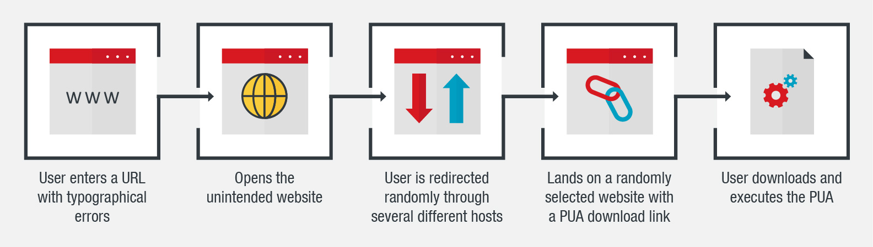
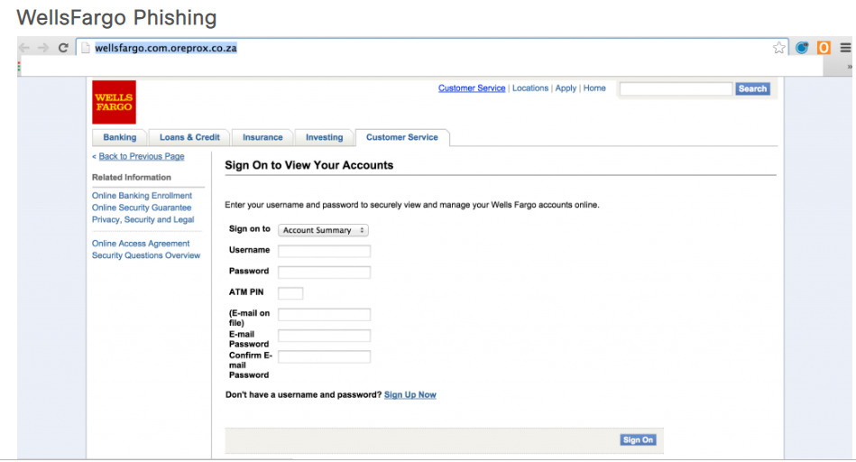
CYBER SQUATTING Anticybersquatting Consumer Protection Act (ACPA)

Slide 11

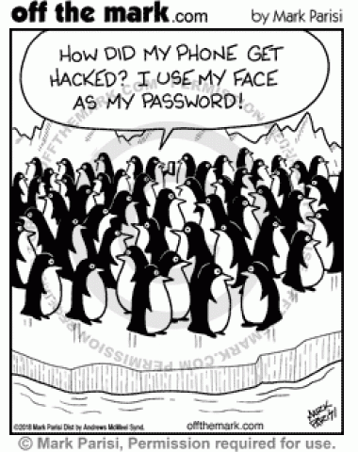
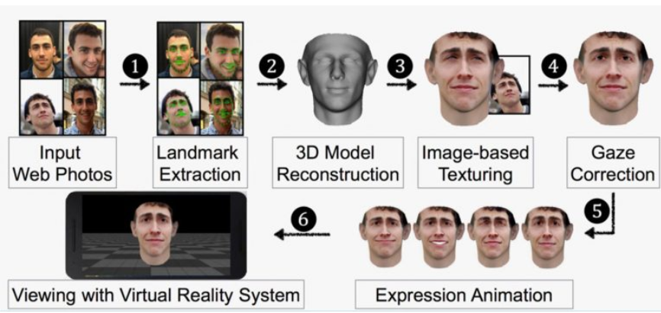
FACIAL RECOGNIZATION A THREAT!
Facebook Photos Lead to Hacking of Facial Recognition System

Slide 12
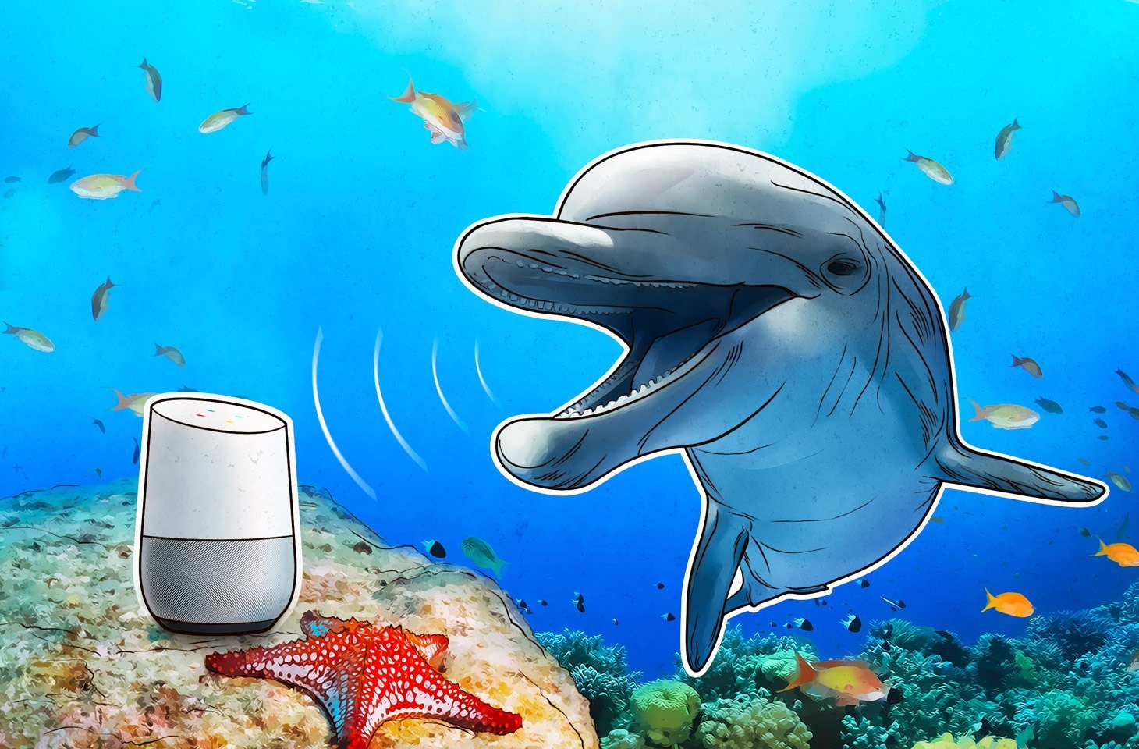

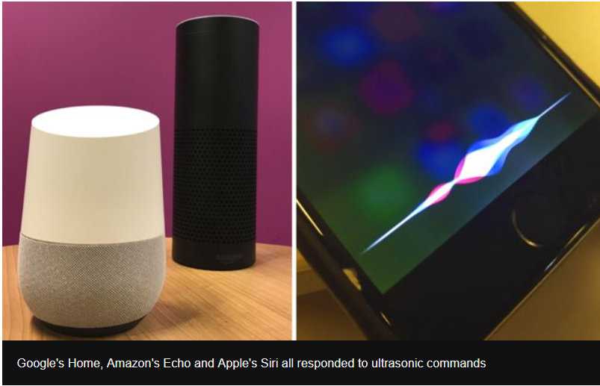
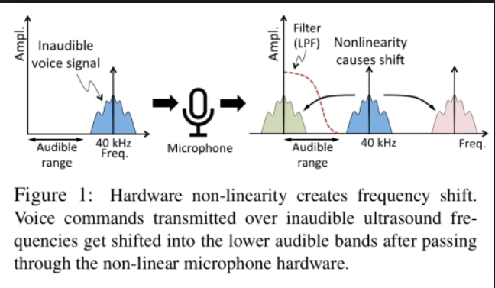
Dolphin Attack!
I can HACK!

Slide 13
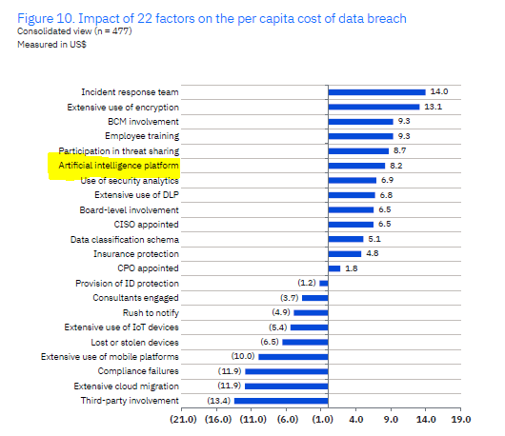
Impact of AI on Data Breach IBM REPORT

Slide 14
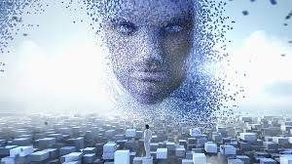
Stephen Hawking warning!
if we can’t learn to control it, AI could be the
“worst event in the history of our civilization.”
THE END

Slide 15
references
https://www.fortinet.com/blog/business-and-technology/fortiweb-release-6-0--ai-based-machine-learning-for-advanced-thr.html
https://s3-us-west-1.amazonaws.com/webroot-cms-cdn/8115/1302/6957/Webroot_QTT_Survey_Executive_Summary_December_2017.pdf
https://pdfs.semanticscholar.org/e523/c0eb8ada3256f42c435da8d7def74d4fe037.pdf
https://www-cdn.webroot.com/6015/4999/4566/Webroot_AI_ML_Survey_US-2019.pdf
https://pdfs.semanticscholar.org/e523/c0eb8ada3256f42c435da8d7def74d4fe037.pdf

